Slide 1
FAST FOOD RESTURANT
Management System
Client Name: Taimoor Khan

Slide 2
Group Members
Ammar Khan p15-6042
Mudassir Athar p15-6079
Sabahat Ijaz p16-6055
Noormah Omar Khan p16-6040
Laiba Gul p16-6117
Muhammad Toqeer p16-6069
Hamza Bukhari p16-6058
Muhammad Hamza p16-6068
Yousaf Khan p16-6059

Slide 3
objective
As we know today world is of technology. Computer is basic need of every field. This project will facilitate every restaurant organization. As it will help store information and calculation about their profits, sales and employees etc.
To build a software for FAST FOOD RESTURANT which would help the admin or Manager to analyse their sales and control sales and customers and Operators.

Slide 4
Background
Client need a software in which he records day to day business.

Slide 5
Actors of the system:
Operator
Admin

Slide 6
Requirements
Admin login
Operator login
Remove items, promotions, deals, operators, customer (by admin)
Add items ,promotions, deals, operators (by admin)
Add customer and sales (by operator)

Slide 7
team
Team of 9 people
3 are developers
2 are analysts
3 are designers
1 member is of Testing

Slide 8
Proposed Solution
We choose Agile Model
Based on 6 iterations
1st for Inception Phase
2nd and 3rd Elaboration phase
4th and 5th Construction phase
6th and final Transition Phase

Slide 9
1st Deliverable
Inception Phase
Core of the project
Top requirements
Goals
Team Making

Slide 10
2nd Deliverable
Gather More Requirements
High Rank Requirements
Take Order
Cancel/Update Order
Use case diagram
And Some fully dressed Use cases

Slide 11
3rd Deliverable
2nd Iteration of Elaboration Phase
More Use Cases
Proto Type
One fully implemented function(Login)
And Data Model

Slide 12
4th Deliverable
Implementation of High Risk Element
Sequence Diagram
Domain Model
Activity Diagram

Slide 13
5th Deliverable
Fully implemented Project
Sequence Diagram
Domain Model
Activity Diagrams
Class Diagram

Slide 14
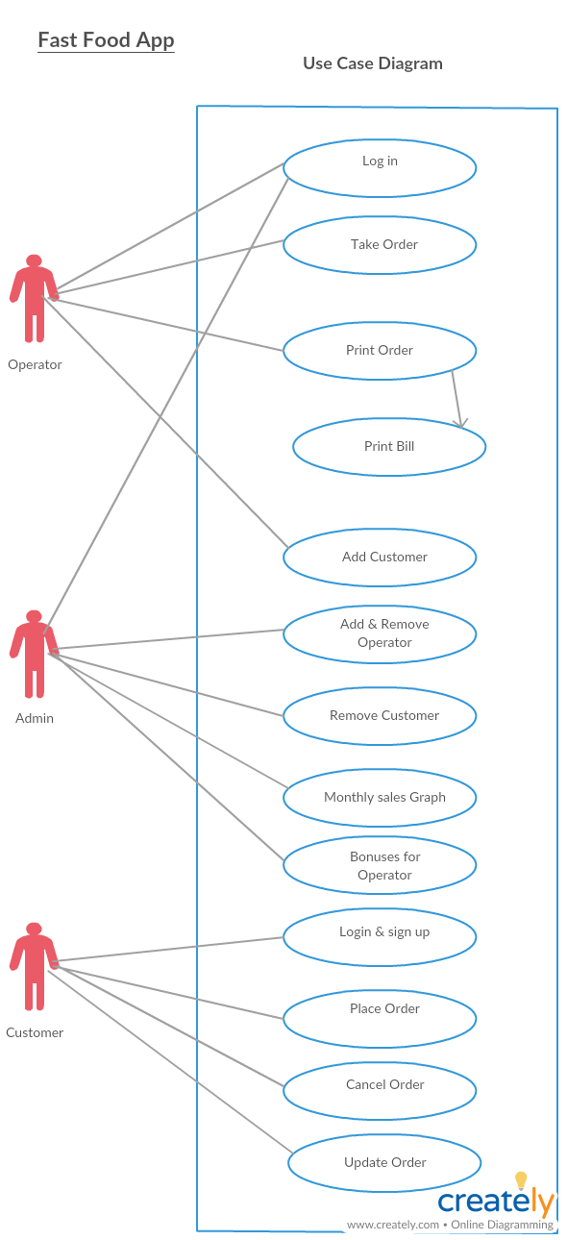
Use case diagram

Slide 15
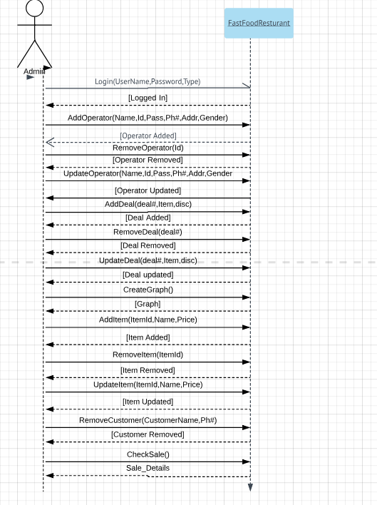
Admin SSD

Slide 16
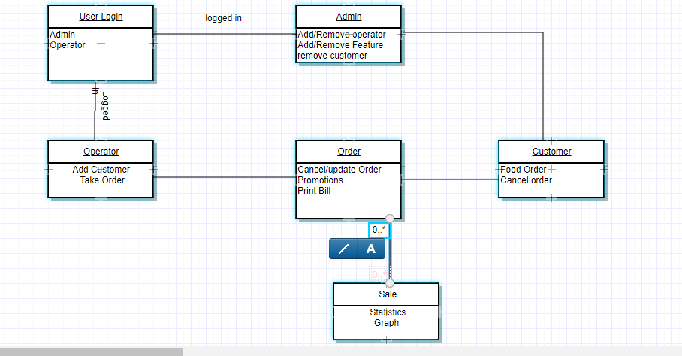
Domain model

Slide 17
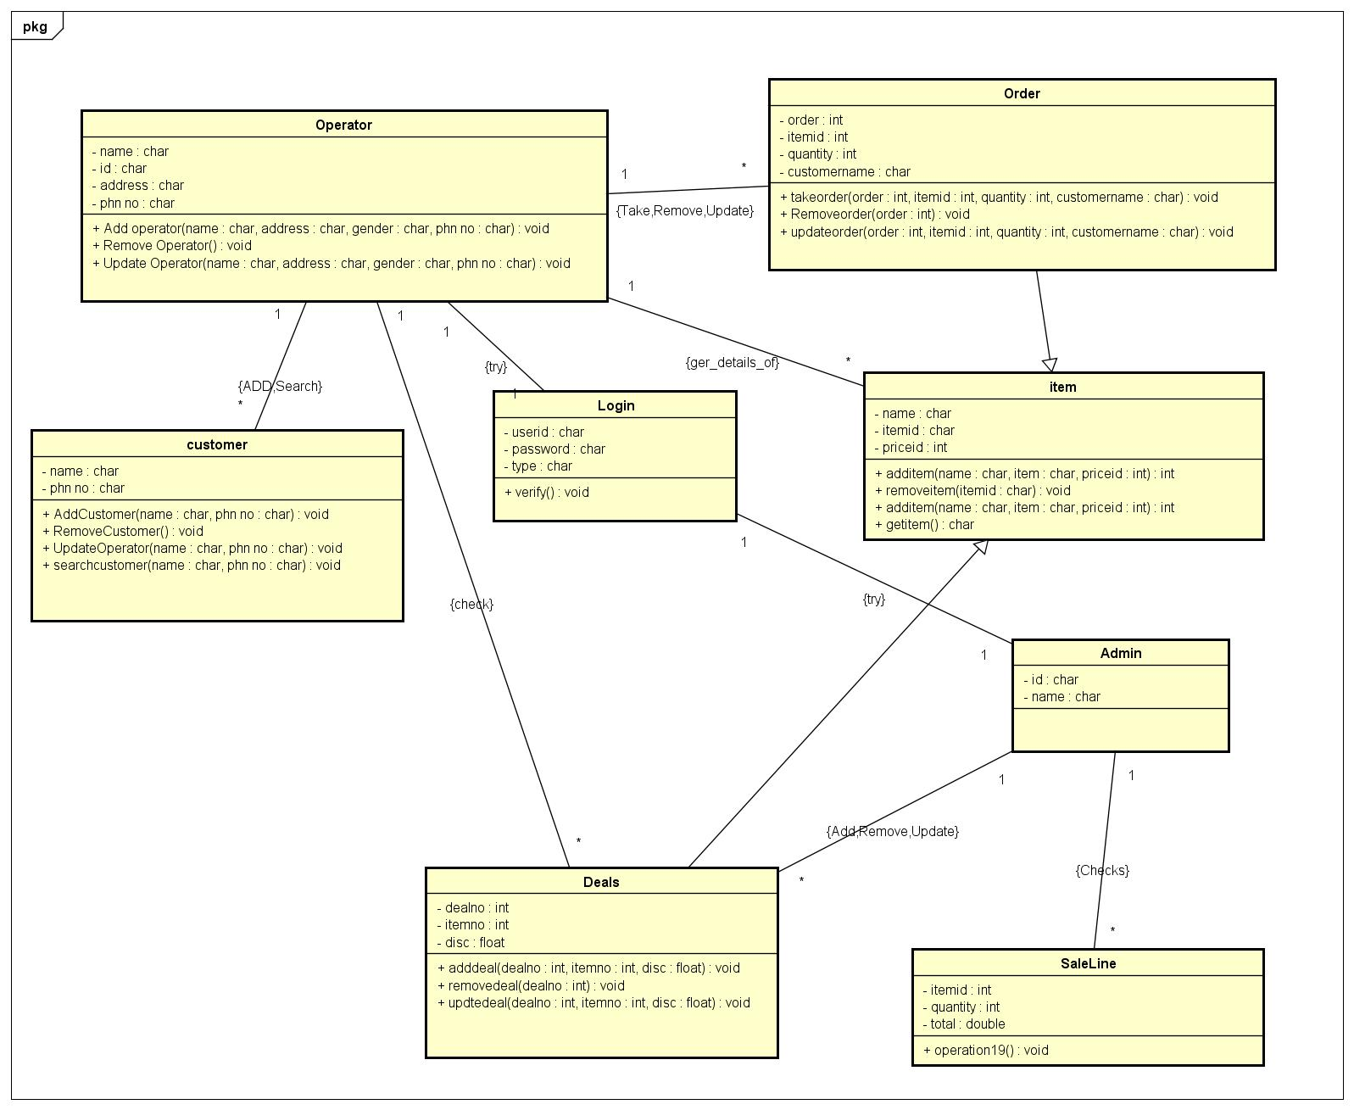
Class diagram

Slide 18
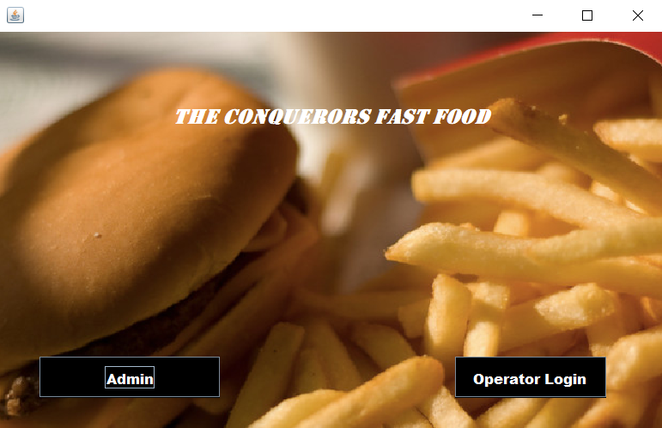
Interface Snapshot

Slide 19
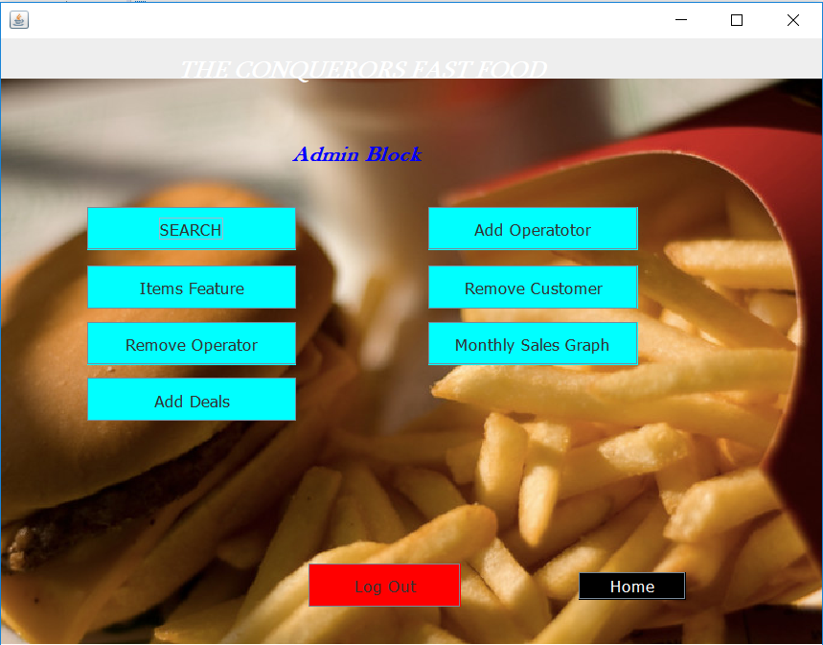
Interface Snapshot

Slide 20
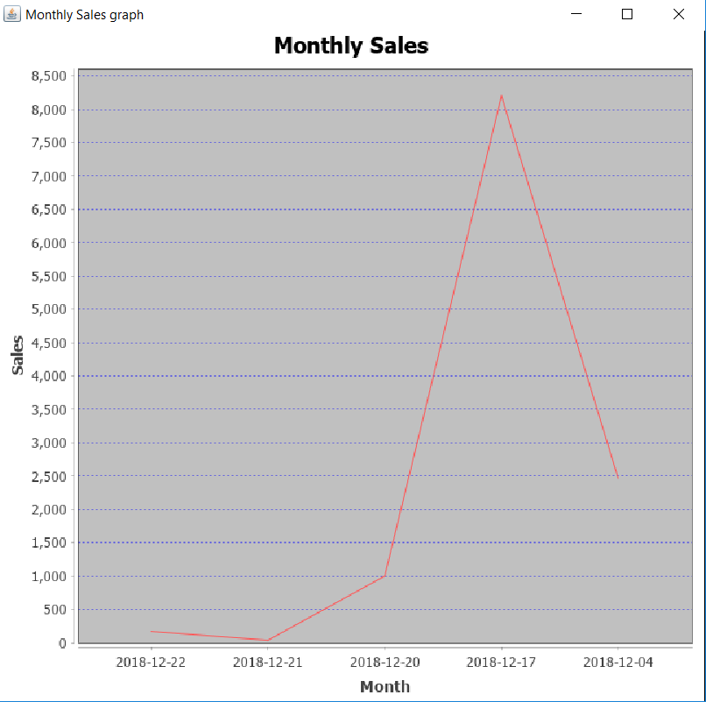
Interface Snapshot

Slide 21
Any Suggestion or question

